Slide 1
Image Stitching and inpainting
Enee 631
Sayantan Sarkar

Slide 2
Contents
Image Stitching
Introduction
Equalization
SIFT
RANSAC
Image Blending
Implementation
Results
Image Inpainting
Introduction
Algorithm
Implementation
Results
Android
References

Slide 3
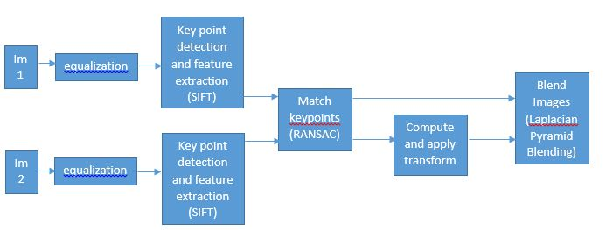
Image Stitching: Introduction
Image Stitching is used to create wide angle panoramas out of multiple images, which capture a scene from multiple viewpoints which have overlapping portions.

Slide 4
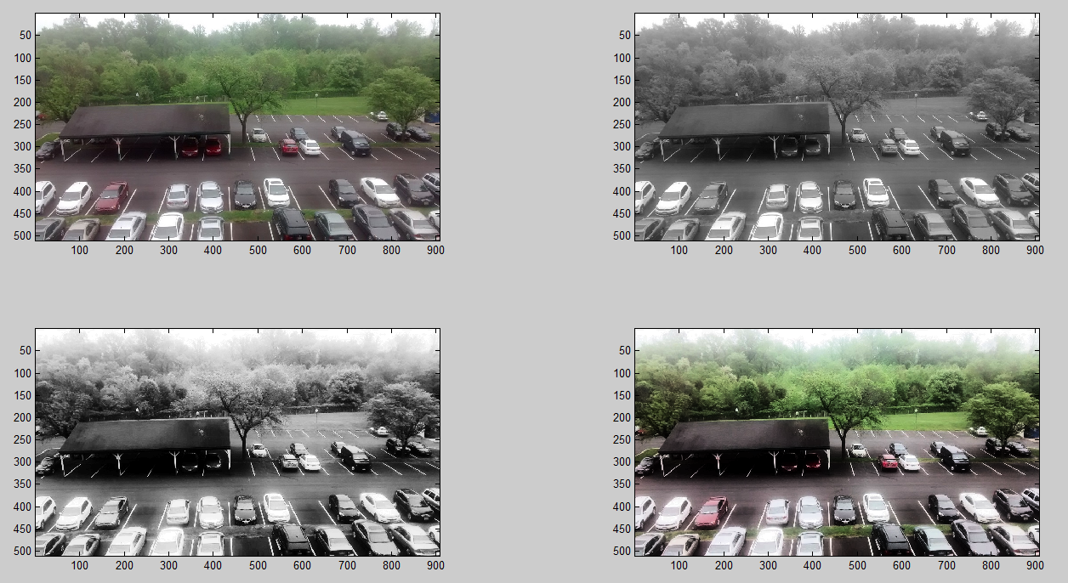
Image Stitching: Equalization
Given 2 images, we may want to equalize them if necessary.
Equalization is done in the V channel of HSV colour model

Slide 5
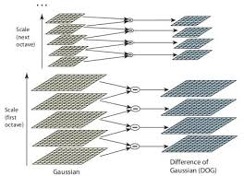
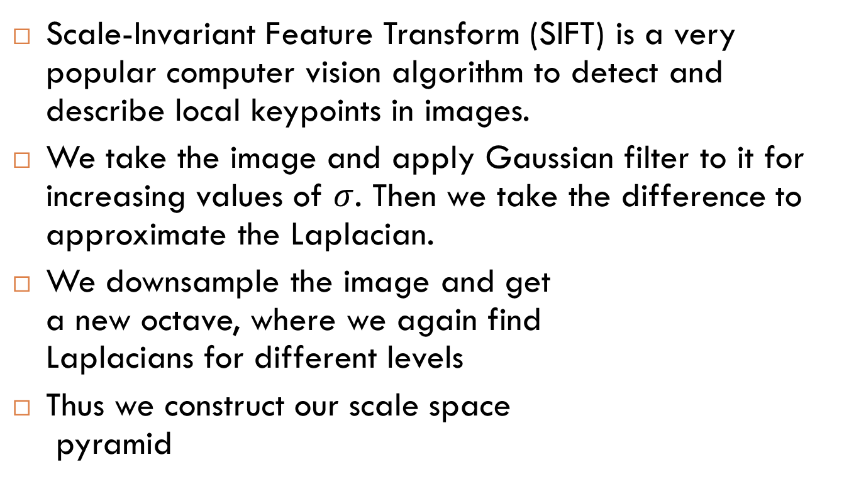
Image Stitching: SIFT
Scale-Invariant Feature Transform (SIFT) is a very popular computer vision algorithm to detect and describe local keypoints in images.
We take the image and apply Gaussian filter to it for increasing values of $σ$. Then we take the difference to approximate the Laplacian.
We downsample the image and get a new octave, where we again find Laplacians for different levels
Thus we construct our scale space pyramid

Slide 6
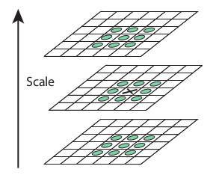
Image Stitching: SIFT
We find extrema points in the Laplacians by comparing a point to its neighbours and also to the points a level above and below
Sub pixel correction and thresholding is applied to remove false keypoints

Slide 7
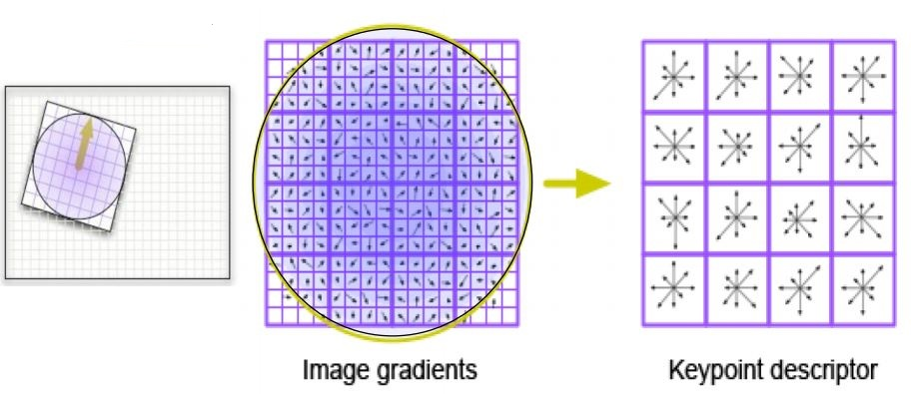
Image Stitching: SIFT
SIFT features are calculated on the remaining keypoints
SIFT features are basically a histogram of orientations of gradient angles weighted by their magnitudes and a Gaussian window in a rotated window.

Slide 8
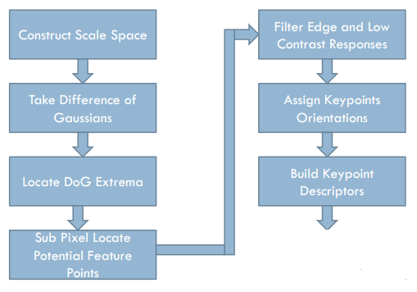
Image Stitching: SIFT

Slide 9
Image Stitching: RANSAC
Random Sampling Consensus is an iterative non deterministic algorithm to estimate parameters in a mathematical model from a set of observed data which may contain outliers.
In our setting we need at least 4 points to fit (using least squares solution) the model using the projective geometry equation.

Slide 10
Image Stitching: RANSAC
Fit a model using a random subset of datapoints.
Find how many points in the whole dataset it this model within a tolerance value.
If enough points fit then return this model or keep track of the best model o far and return it when a predetermined number of iterations are over.

Slide 11
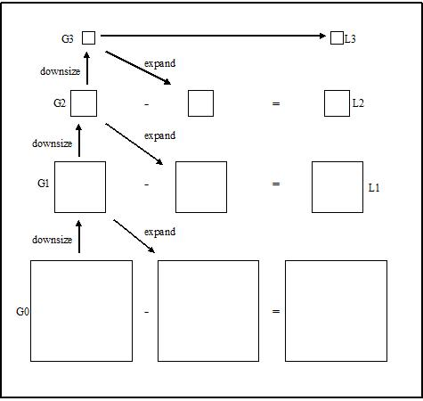
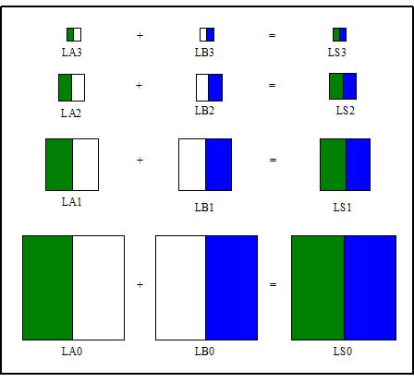
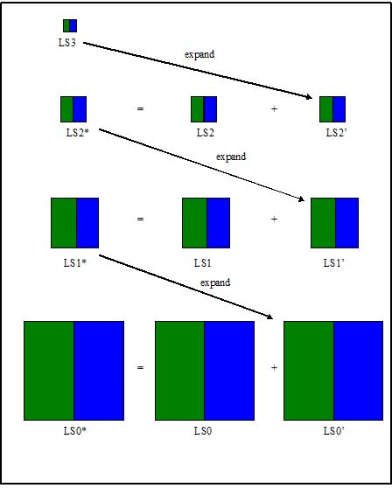
Image Stitching: Image Blending
Laplacian Pyramid Blending technique
Create a Laplacian pyramid
Blend the images at each level
Reconstruct by back tracking up the pyramid

Slide 12
Image Stitching: Implementation
2 Modes were implemented. Mode 1 fused 2 images. Mode 2 fuses frames from a video to get the panorama.
2 Implementations both in MATLAB: 1st is the pipeline I described, the second is using MATLAB’s inbuilt functions

Slide 13
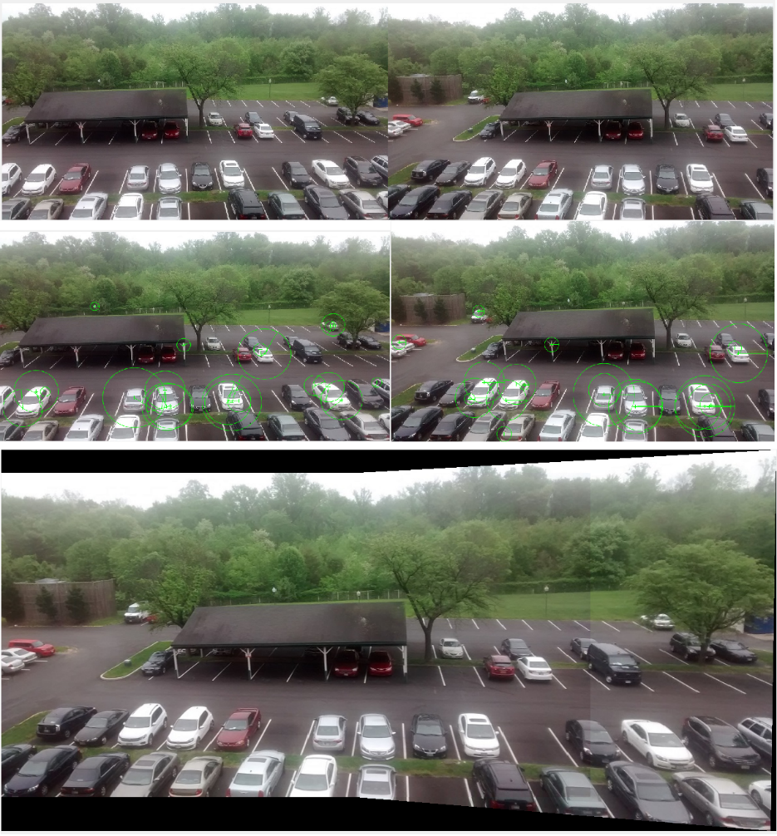
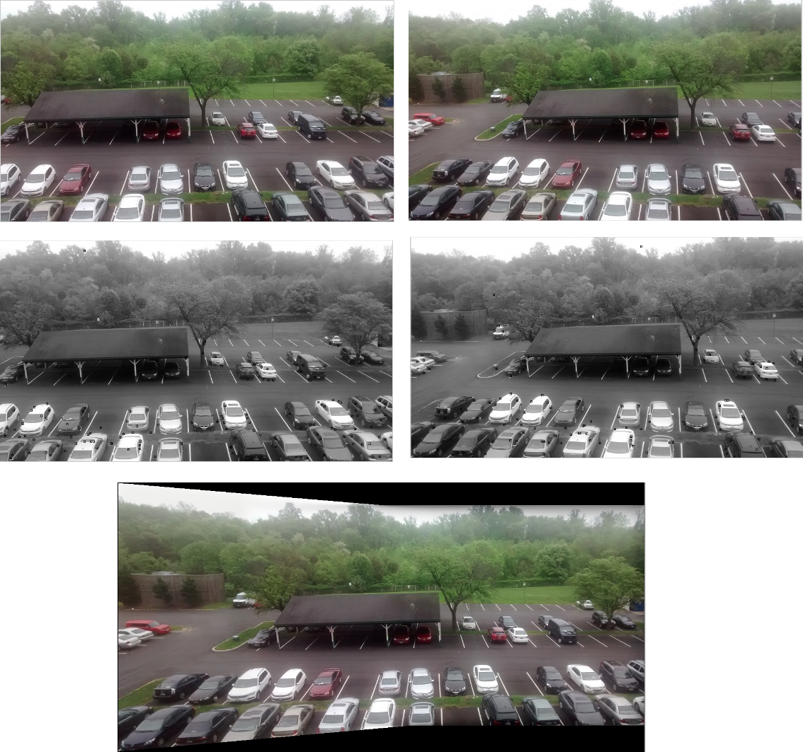
Image Stitching: Results
Left: Inbuilt functions, Right: My pipeline

Slide 14
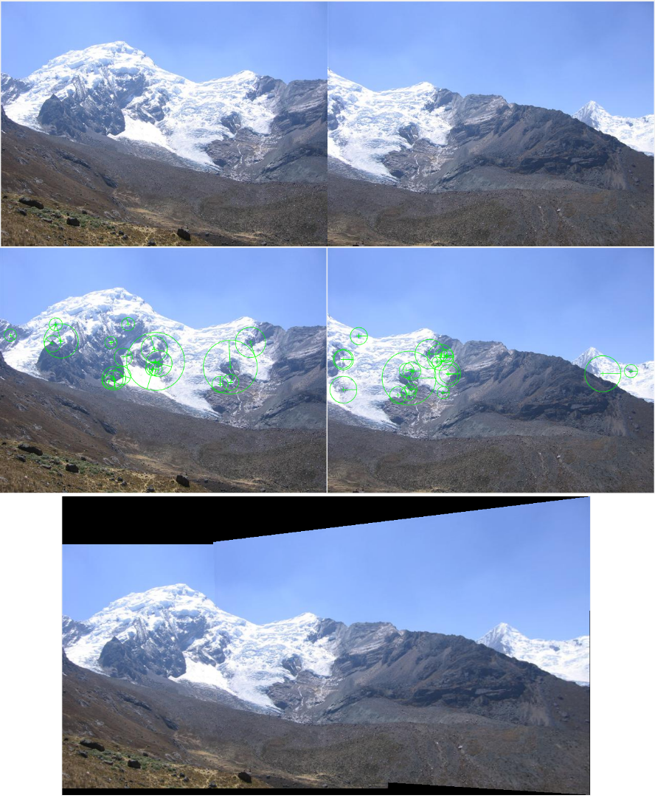
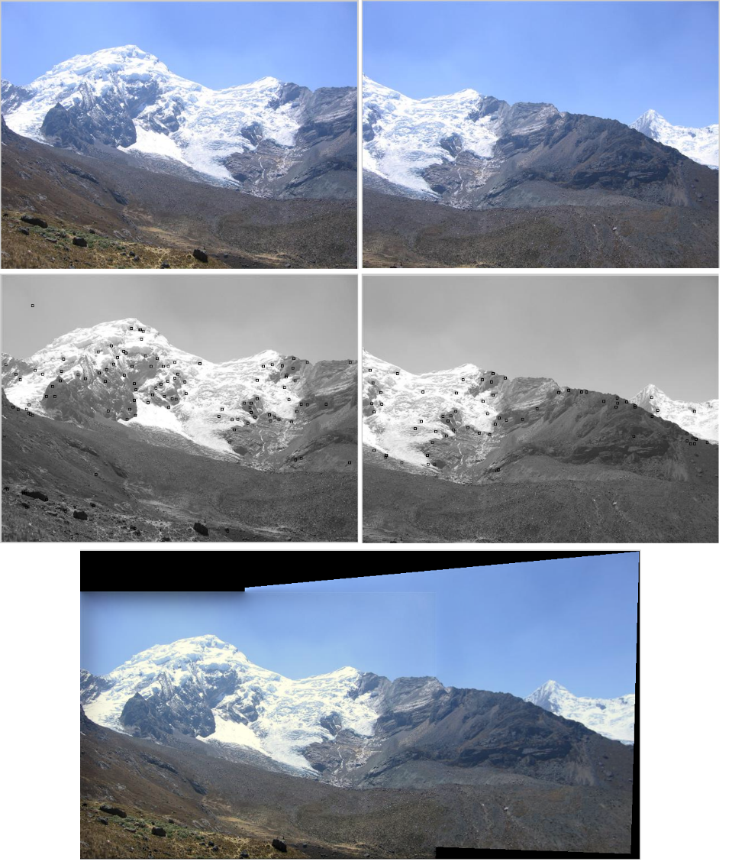
Image Stitching: Results
Left: Inbuilt functions, Right: My pipeline

Slide 15
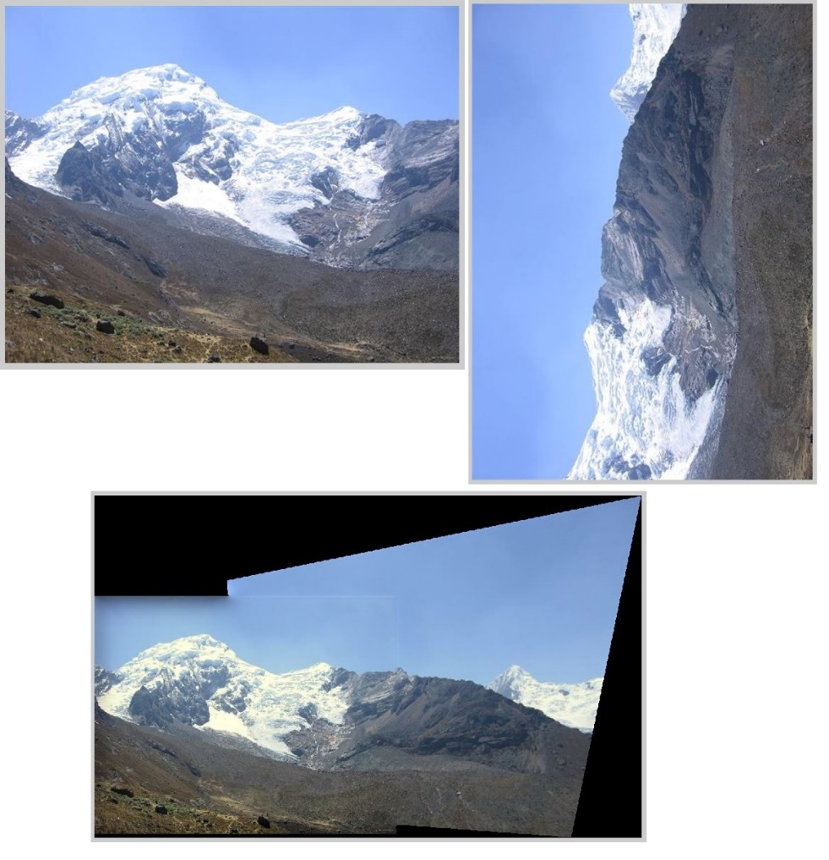
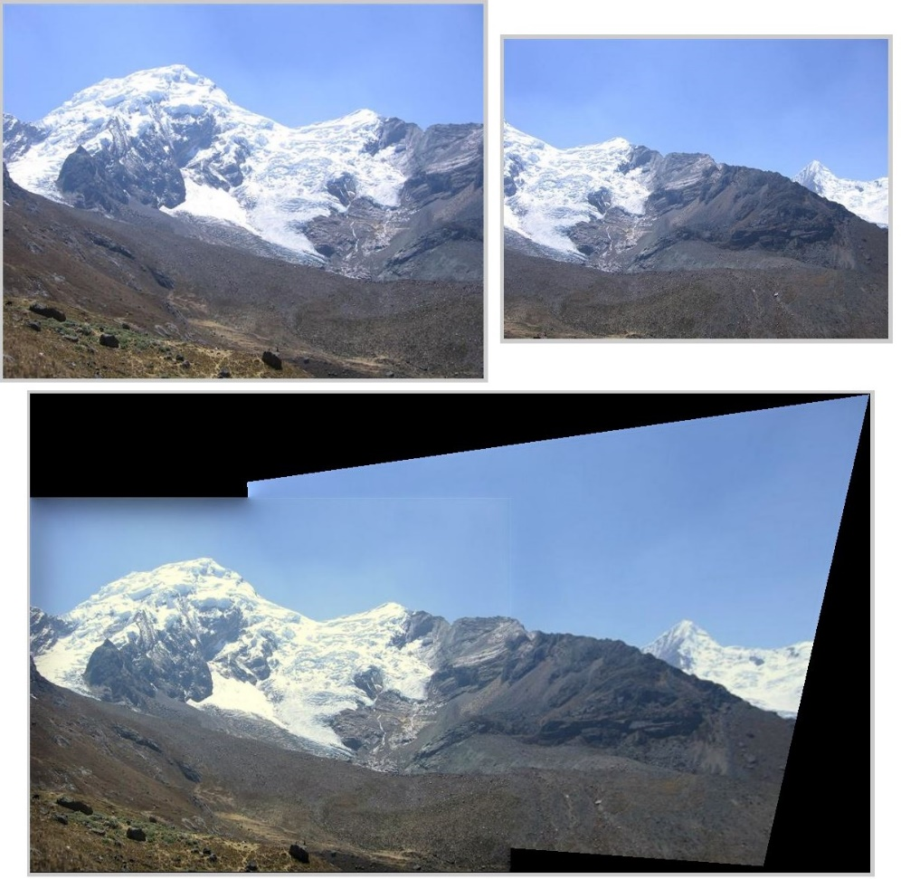
Image Stitching: Results
Stitching rotated images and images of different scales

Slide 16
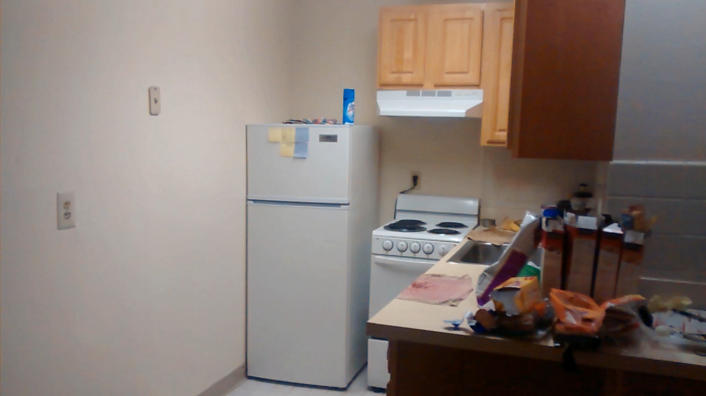
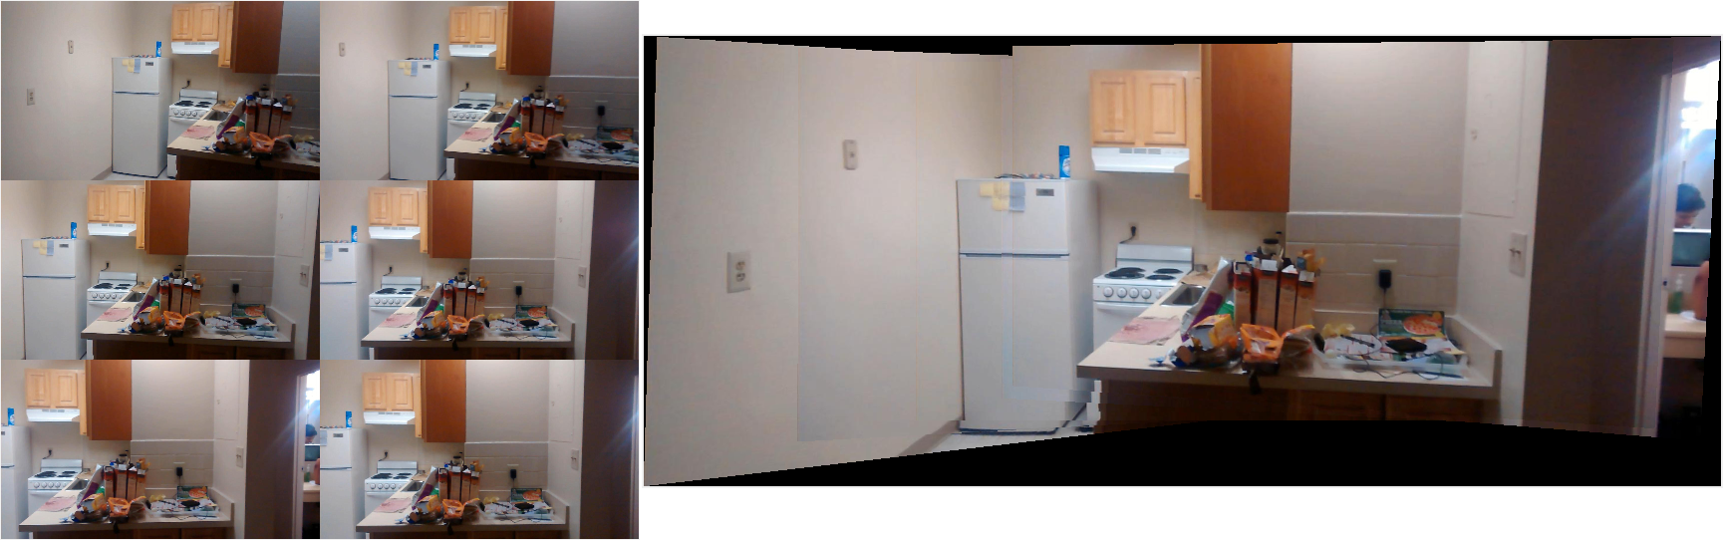
Image Stitching: Results
Video

Slide 17
Image Inpainting: Introduction
Image Inpainting is the process of reconstructing lost or deteriorated parts of images.
Useful for
Restoring old and damaged images
Restore pixels lost during transmission
Remove unwanted objects from an image

Slide 18
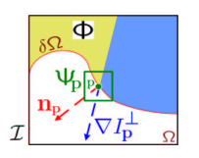
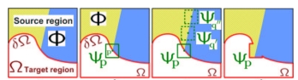
Image Inpainting: Algorithm
Implemented Exemplar based Inpainting as described by Criminisi, Perez and Toyoma
Find a priority point in the fill front using data and confidence term. Data term supports propagation of isophotes, confidence term supports a concentric fill order
Find a patch in the source region that best matches the priority patch and fill it using that.

Slide 19
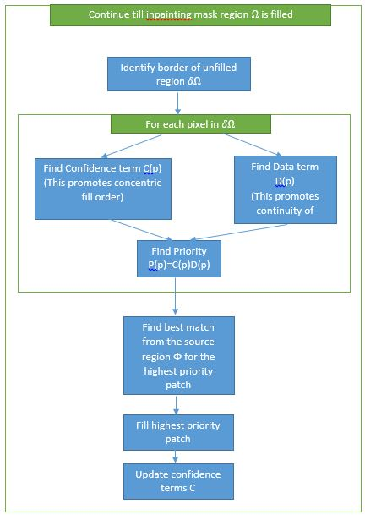
Image Inpainting: Algorithm

Slide 20
Image Inpainting: Implementation
Implemented in C++ (using OpenCV) in Windows
3 modes were implemented
Mode 1: Polygon Mask
Left click to define vertices of a polygon which form a mask
Useful for object removal
Mode 2: Thresholding in Polygon Mask
Left click to define vertices of a polygon that bounds a region of interest
Right click a point that is in the background and is to be removed
Thresholding is applied to infer a mask
Useful to define complex masks (eg for timestamp removal)
Mode 3. Global inpainting
Control + left click on a point and all points with similar colour are considered part of
Useful to define multiple regions in one shot

Slide 21
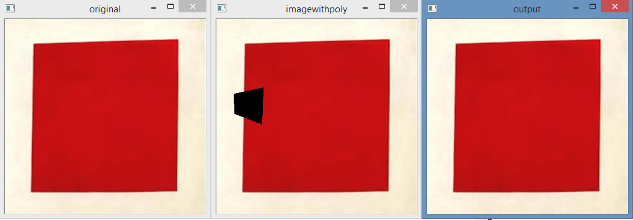
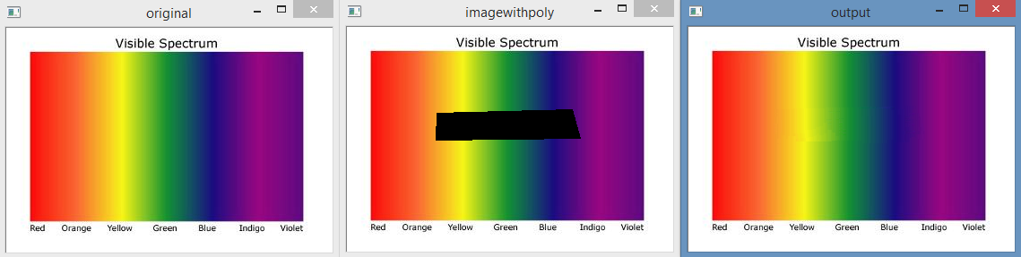
Image Inpainting: Results: Mode 1
Isophote Propagation

Slide 22
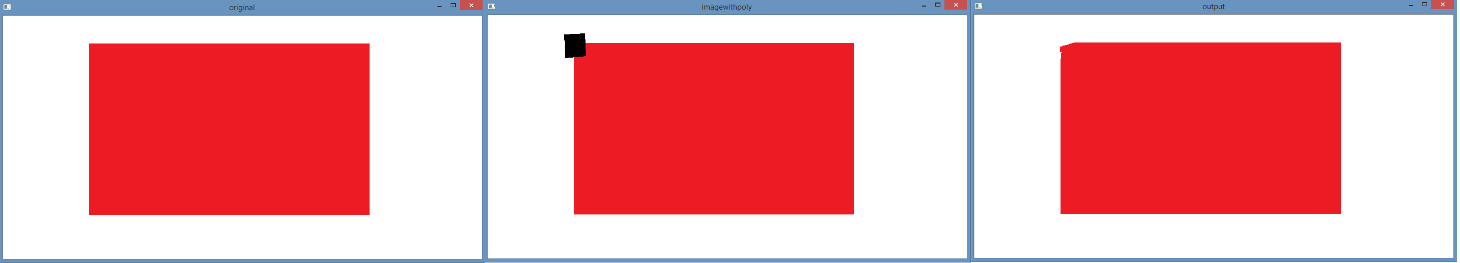
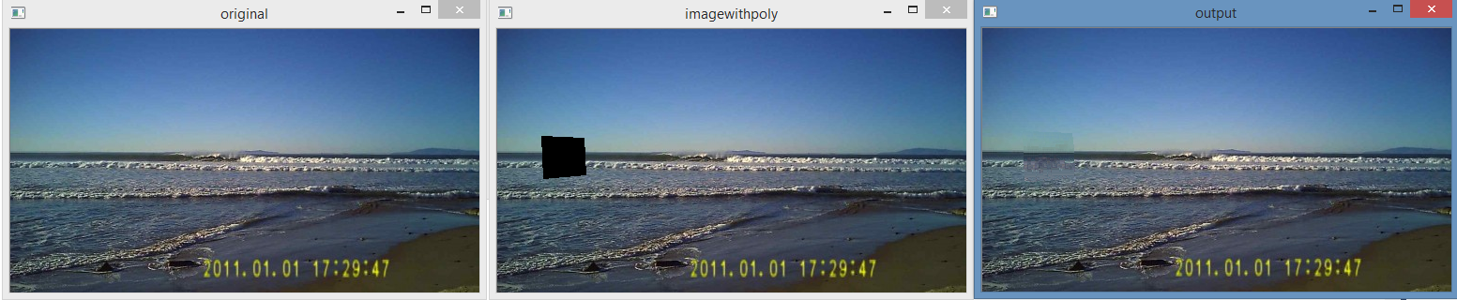
Image Inpainting: Results: Mode 1
Isophote Propagation

Slide 23
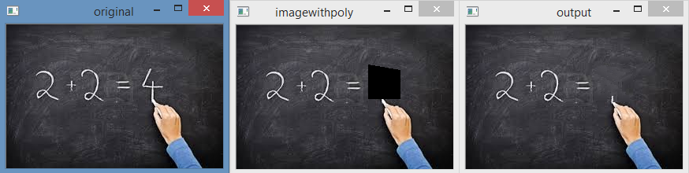
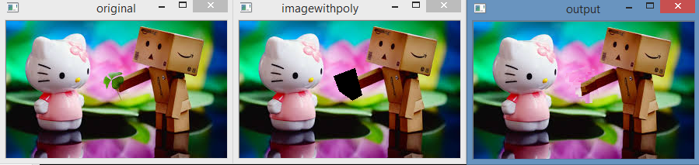
Image Inpainting: Results: Mode 1
Object removal

Slide 24
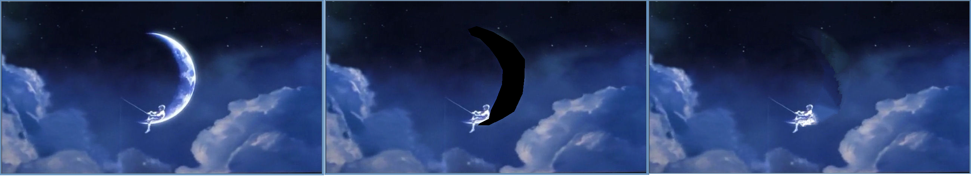
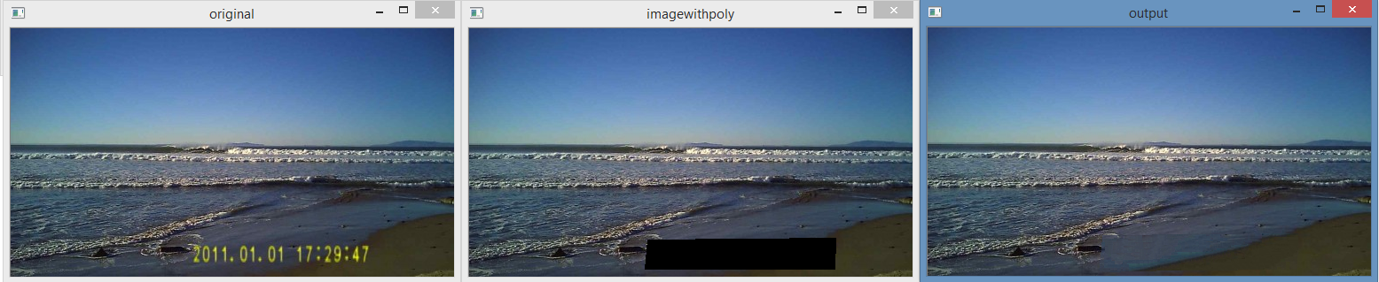
Image Inpainting: Results: Mode 1
Object removal

Slide 25
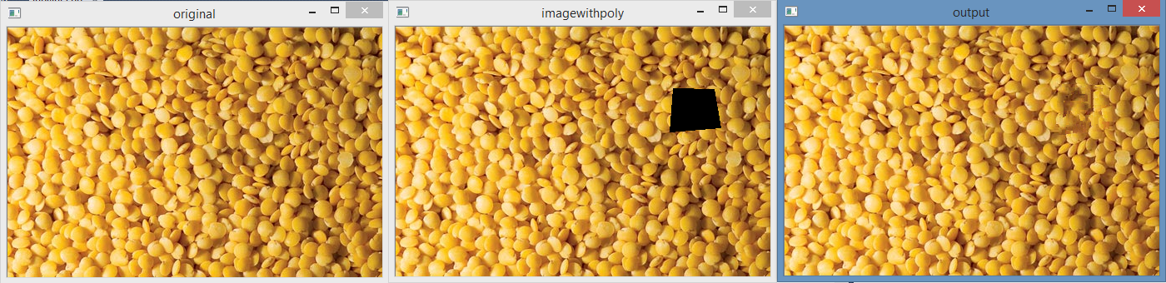
Image Inpainting: Results: Mode 1
Texture Generation

Slide 26
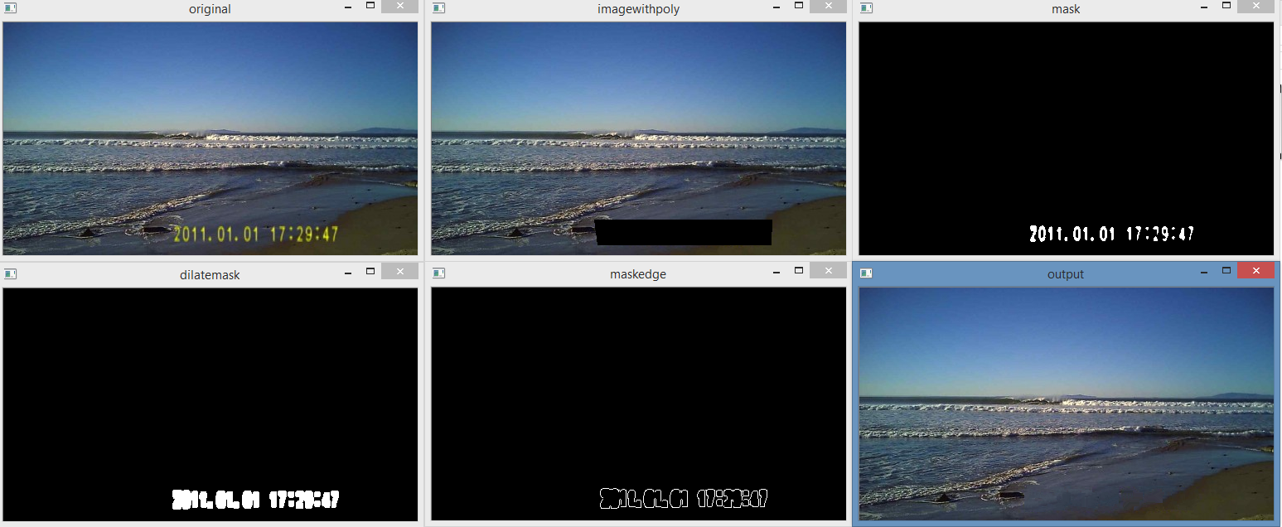
Image Inpainting: Results: Mode 2

Slide 27
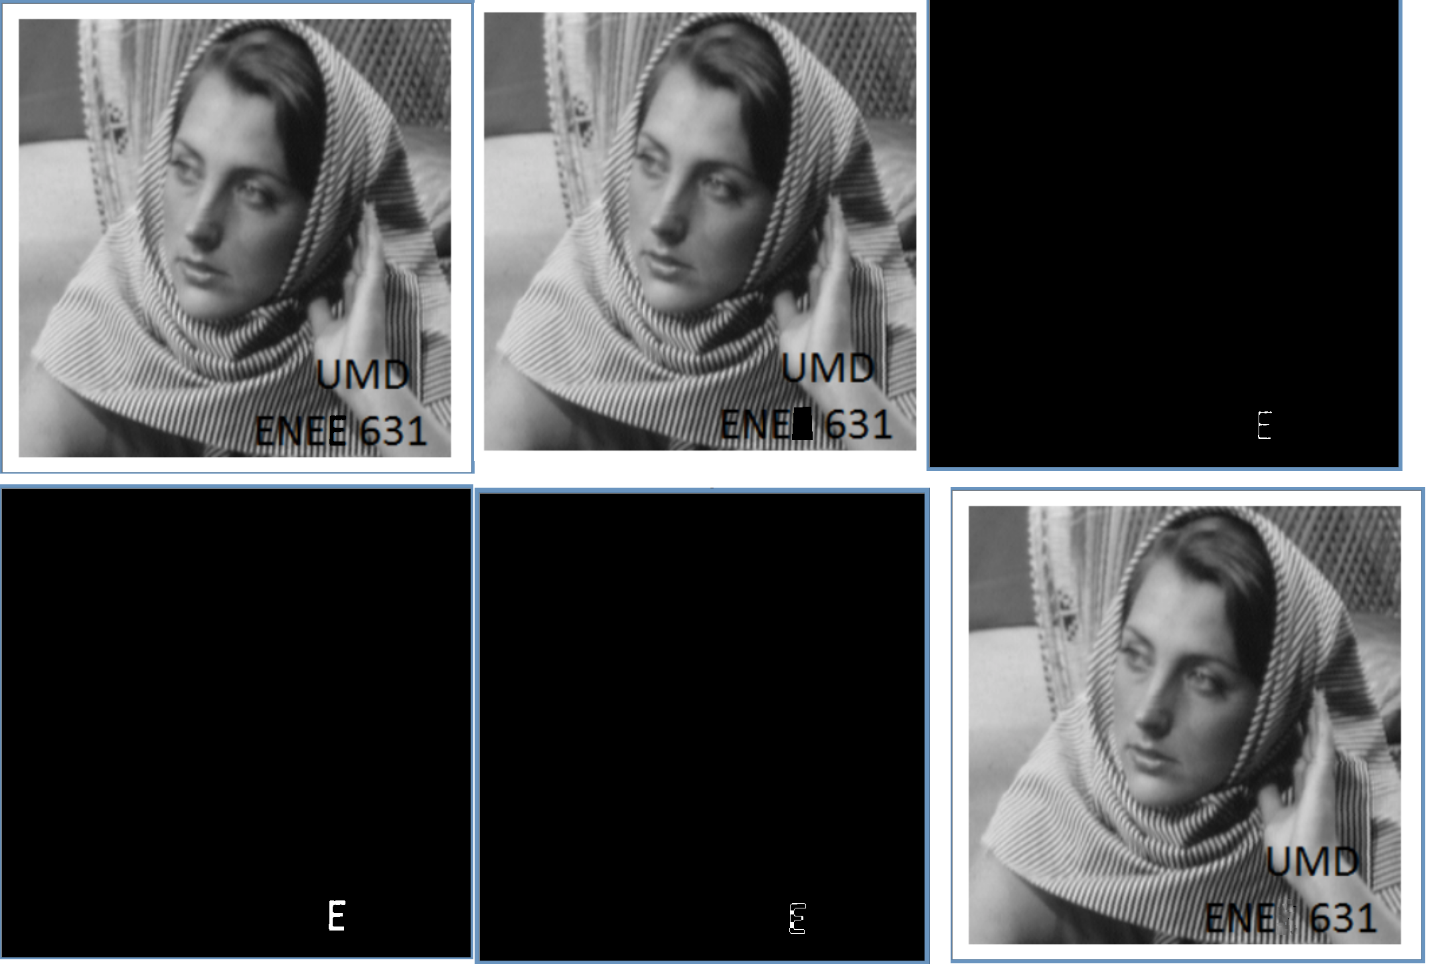
Image Inpainting: Results: Mode 2

Slide 28
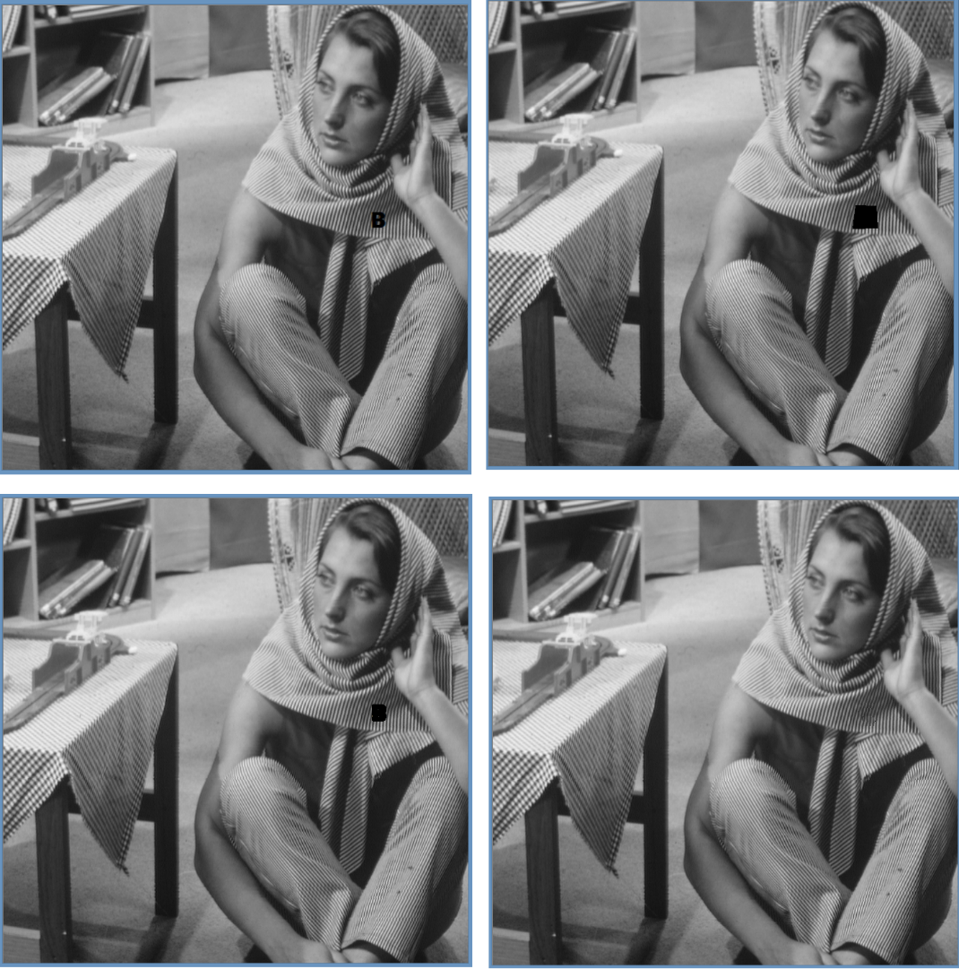
Image Inpainting: Results: Mode 2

Slide 29
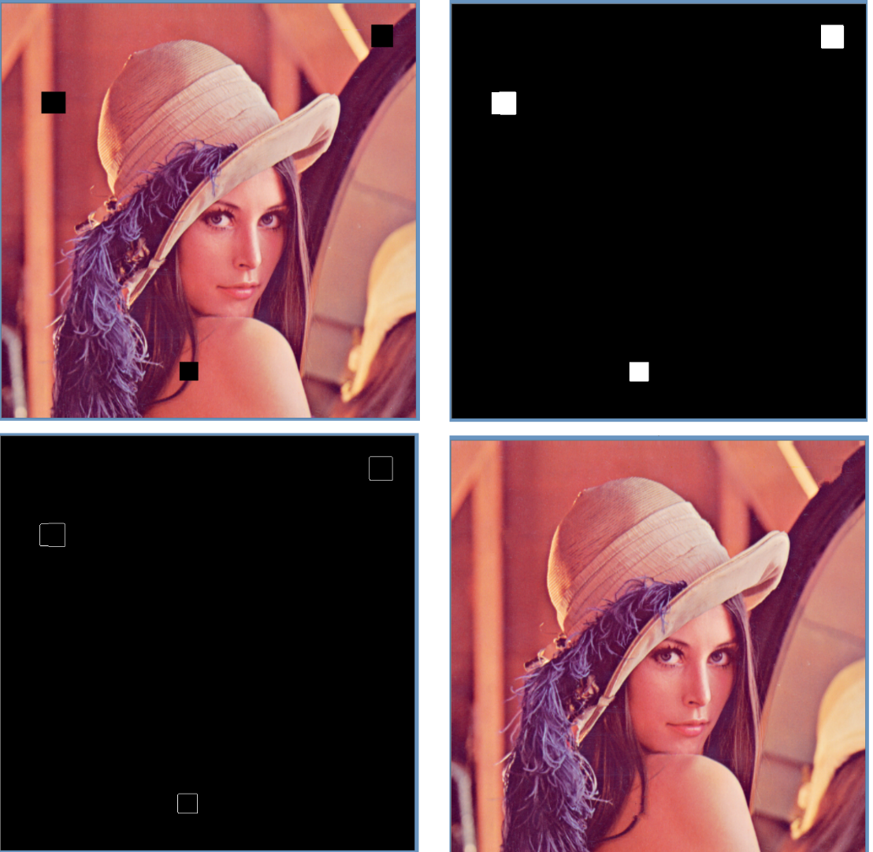
Image Inpainting: Results: Mode 3

Slide 30
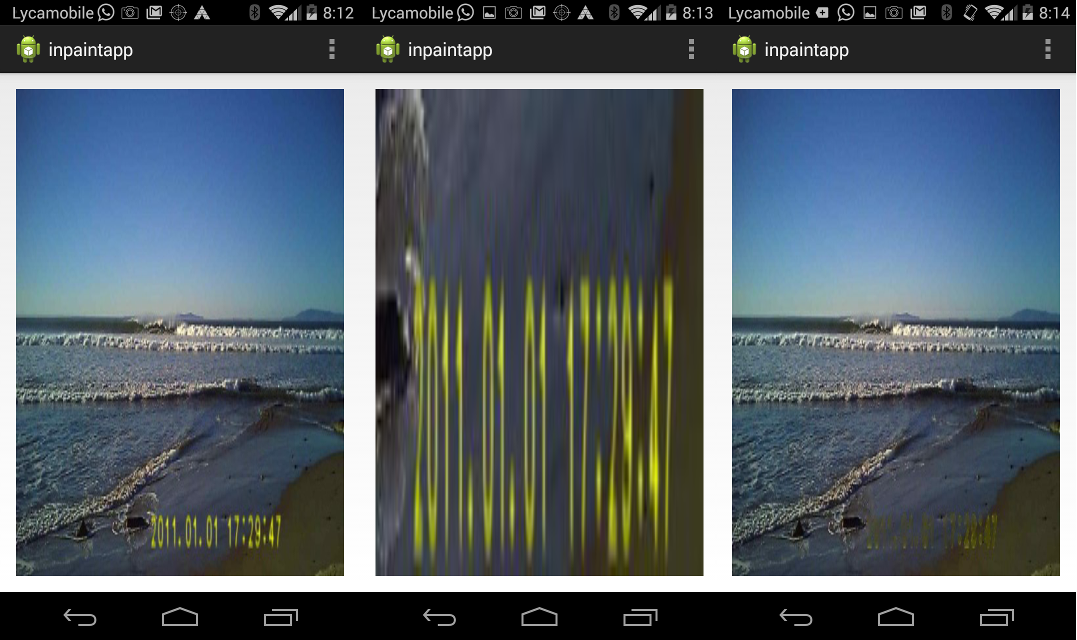
Image Inpainting: Android
Also developed an app in android to do inpainting using inbuilt functions in OpenCV
User can select a rectangular region of interest. Otsu’s Thresholding is performed that gives a mask. Then inpainting is done.

Slide 31
References
General
[1] http://en.wikipedia.org/wiki/Image_stitching
[2] http://en.wikipedia.org/wiki/Inpainting
[3] Szeliski, Richard. "Image alignment and stitching: A tutorial." Foundations and Trends® in Computer Graphics and Vision 2.1 (2006): 1-104.
[4] http://www.mathworks.com/help/vision/examples/feature-based-panoramic-image-stitching.html
SIFT
[5] http://www.inf.fu-berlin.de/lehre/SS09/CV/uebungen/uebung09/SIFT.pdf
[6] https://www.youtube.com/watch?v=NPcMS49V5hg
[7] http://web.eecs.umich.edu/~silvio/teaching/EECS598/lectures/lecture10_1.pdf
RANSAC
[8] http://en.wikipedia.org/wiki/RANSAC
[9] http://www.cse.yorku.ca/~kosta/CompVis_Notes/ransac.pdf
Blending
[10] http://graphics.cs.cmu.edu/courses/15-463/2005_fall/www/Lectures/Pyramids.pdf
[11] http://www.cs.toronto.edu/~jepson/csc320/notes/pyramids.pdf
[12] Burt, P. J. and Adelson, E. H., A multiresolution spline with applications to image mosaics, ACM Transactions on Graphics, 42(4), October 1983, 217-236
[13] http://pages.cs.wisc.edu/~csverma/CS766_09/ImageMosaic/imagemosaic.html
Inpainting
[14] Toyama, C. E., Criminisi, A., Pérez, P., & Toyama, K. (2003). Object removal by exemplar-based inpainting.

